Slide 1



OOP Fundamentals Part I
Encapsulation and Inheritance
SoftUni Team
Technical Trainers
Software University
http://softuni.bg

Slide 2
Check list
Class vs. object
Object vs. array
Instance of Class == object
How to reach object properties and methods
Constructors
Public and Private visibility levels

Slide 3


Table of Contents
Encapsulation
Access modifiers
Inheritance
Class hierarchies
Inheritance and access levels

Slide 4
Questions
sli.do #PHP-WEB

Slide 5
Two Fundamental Principles of OOP
Encapsulation – the object as a black box
Hide internal data
Reach internal data by Setters and Getters
Inheritance – classes in relations
Inherit members from parent class
Call a constructor from parent class

Slide 6

Encapsulation

Slide 7
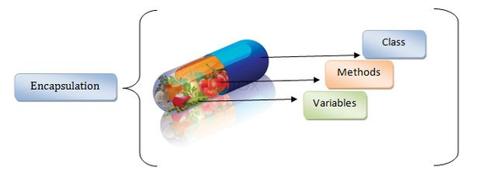
Encapsulation
Encapsulation - wrapping up related data and methods in one module.
Restrict the direct access to members by using setters and getters
Notes:
Encapsulation hides the implementation details
Class announces only a few operations (methods) available for its clients – its public interface
All data members (fields) of a class should be hidden
Accessed via properties (read-only and read-write)
No interface members should be hidden
Encapsulation == hide (encapsulate) data behind constructors and properties

Slide 8

Visibility and Encapsulation
Parent Child Grandchild Global scope
private
protected
public

Slide 9
Visibility
There are three visibility levels in PHP
Available only to the class and its
children
class Person {
protected $age;
private $gender;
public function __construct($age, $gender) {
$this->setAge($age);
$this->setGender($gender);
}
public function setAge($age) {
$this->age = $age;
}
Available only to the class itself
Available everywhere
Notes:
Encapsulation hides the implementation details
Class announces only a few operations (methods) available for its clients – its public interface
All data members (fields) of a class should be hidden
Accessed via properties (read-only and read-write)
No interface members should be hidden
Encapsulation == hide (encapsulate) data behind constructors and properties

Slide 10
Visibility (2)
public function setGender($gender) {
$this->gender = $gender;
}
public function getGender() {
return $this->gender;
}
public function getAge() {
return $this->age;
}
}
$newPerson = new Person(12, "male");
echo $newPerson->getGender();
Notes:
Constructors are declared public
Constructors perform checks to keep the object state valid
Interface methods are always public
Not explicitly declared with public
Non-interface methods are declared private / protected

Slide 11
Getters and Setters
You can define your own setters and getters
Using getters and setters you can control data validation
public function getAge() {
return $this->age;
}
public function setAge($age) {
if ($age < 18)
throw new Exception('Should be an adult');
else
$this->age = $age;
}
Notes:
Constructors are declared public
Constructors perform checks to keep the object state valid
Interface methods are always public
Not explicitly declared with public
Non-interface methods are declared private / protected

Slide 12
Magic Setters and Getters
__set() is run when writing data to inaccessible properties
__get() is utilized for reading data from inaccessible properties
Data validation is not so flexible this way
public function __set($name, $value) {
$this->{$name} = $value;
}
public function __get($name) {
return $this->{$name};
}
Notes:
Exception in PHP is an object, which signals an error or an event, which is not anticipated in the normal program flow. When such unusual event takes place, the executing method ’throws' a special object containing information about the type of the error, the place in the program where the error occurred as well as the program state at the moment of the error.
Each exception in PHP contains the so-called stack trace, which gives information of where exactly the error occurred.

Slide 13
Problem: Employee Class
Every Employee should have:
First and last name
Salary and age
Salary should not be visible outside the class but visible for child classes
Salary should be bigger than 0 and must have a way to increase that salary. Lowest increase is 10%
Every employee should be at least 16 years old

Slide 14
Solution: Employee Class
class Employee {
public $fname;
public $lname;
protected $salary;
private $age;
public function __construct($fname, $lname, $age, $salary) {
$this->fname = $fname;
$this->lname = $lname;
$this->setSalary($salary);
$this->setAge($age);
}

Slide 15
Solution: Employee Class (2)
public function increaseSalary($increase) {
if ($increase < 10) {
throw new Exception('Invalid increase');
}
$this->salary *= (1 + $increase / 100);
}
public function setSalary($salary) {
if ($salary < 1) {
throw new Exception('Invalid salary');
}
$this->salary = $salary;
}

Slide 16
Solution: Employee Class (3)
public function setAge($age) {
if ($age < 16) {
throw new Exception('Invalid age');
}
$this->age = $age;
}
}
$employee = new Employee('Gosho','Petrov',25,5000);
$employee->increaseSalary(15);

Slide 17

Encapsulation
Live Exercises in Class (Lab, part 1)

Slide 18
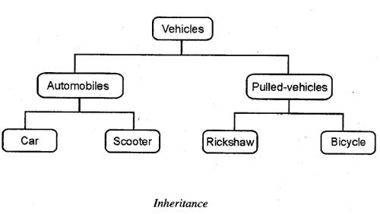
Class Inheritance
Notes:
(c) 2006 National Academy for Software Development - http://academy.devbg.org*
18##

Slide 19
Class Inheritance
Base (parent, super) class
Classes can inherit (extend) other classes
Child class inherits data + methods from its parent
Child class can:
Add properties (data)
Add / replace methods
Add / replace accessor properties
Person
name
email
Child (derived) class
Teacher
subject

Slide 20
Class Inheritance – Example
class Person {
function __construct($name, $email) {
$this->name = $name;
$this->email = $email;
}
}
Person
name
class Teacher inherits Person
email
class Teacher extends Person {
function __construct($name, $email, $subject) {
parent::__construct($name, $email);
$this->subject = $subject;
}
}
Teacher
subject
Invoke the parent constructor

Slide 21
Class Inheritance – Example (2)
$p = new Person("Maria", "maria@gmail.com");
echo "Person: " .
$p->name . ' (' . $p->email . ')';
// Person: Maria (maria@gmail.com)
$t = new Teacher("Ivan", "iv@yahoo.com", "PHP");
echo "Teacher: " . $t->name .
' (' . $t->email . '), teaches ' . $t->subject .')';
// Teacher: Ivan (iv@yahoo.com), teaches PHP

Slide 22
Accessing Parent Members
Person
name
email
__toString()
Teacher
Student
Invoking Parent Methods
subject
course
__toString()
__toString()

Slide 23
Inheriting and Replacing __toString() – Person
class Person {
function __construct($name, $email) {
$this->name = $name;
$this->email = $email;
}
function __toString() {
$className = get_class($this);
return $className . '(name: ' . $this->name . ', email: ' . $this->email . ')';
}
}
More magic methods: http://php.net/manual/en/language.oop5.magic.php

Slide 24
Inheriting and Replacing __toString() – Teacher
class Teacher extends Person {
function __construct($name, $email, $subject) {
parent::__construct($name, $email);
$this->subject = $subject;
}
function __toString() {
$parentString = parent::__toString();
return $parentString . ' subject: ' . $this->subject . ')';
}
}
Invoke __toString() from the base (parent) class

Slide 25
Inheriting and Replacing __toString() – Student
class Student extends Person {
function __construct($name, $email, $course) {
parent::__construct($name, $email);
$this->course = $course;
}
function __toString() {
$parentString = parent::__toString();
return $parentString . ' course: ' . $this->course . ')';
}
}
Invoke __toString() from the base (parent) class

Slide 26
Inheriting and Replacing toString() – Usage
$p = new Person("Maria", "maria@gmail.com");
echo $p;
// Person (name: Maria, email: maria@gmail.com)
$t = new Teacher("Ivan", "iv@yahoo.com", "PHP");
echo $t;
// Teacher (name: Ivan, email: iv@yahoo.com, subject: PHP)
$s = new Student("Ana", "ana@mail.ru", 3);
echo $s;
// Student (name: Ana, email: ana@mail.ru, course: 3)

Slide 27
Inheritance: Important Aspects
There is no multiple inheritance
Constructors are not inherited
Parent constructors are not called implicitly by the engine
Extended class could add new members, but couldn’t remove derived members
New members with the same name hide the inherited ones
Private members are accessible through the parent setters and getters
Public and Protected members are overwritten

Slide 28
Inheritance
Live Exercises in Class (Lab, part2)

Slide 29
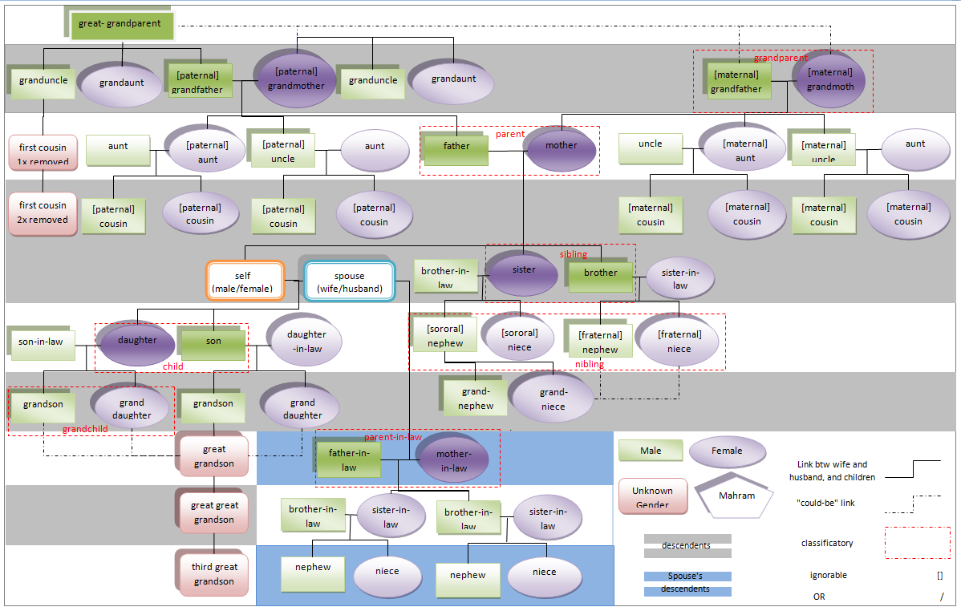

Avoid the Over-Inheritance Trap
A large hierarchy of classes may become non-maintainable
A class is like a scheme or template, so do not extend classes for minor changes
Let the hierarchy model the real-world objects / connections

Slide 30

Summary
Abstraction
Reduces complexity
Encapsulation
Hides internal data
Ensures that structural changes remain local
Access modifiers
Inheritance allows extending the behavior of the classes
Inheriting properties
Inheriting methods
Reusing the existing code

Slide 31








OOP Fundamentals
https://softuni.bg/courses/php-basics/

Slide 32
License
This course (slides, examples, demos, videos, homework, etc.) is licensed under the "Creative Commons Attribution-NonCommercial-ShareAlike 4.0 International" license
Attribution: this work may contain portions from
"PHP Manual" by The PHP Group under CC-BY license
"PHP and MySQL Web Development" course by Telerik Academy under CC-BY-NC-SA license

Slide 33





Free Trainings @ Software University
Software University Foundation – softuni.org
Software University – High-Quality Education, Profession and Job for Software Developers
softuni.bg
Software University @ Facebook
facebook.com/SoftwareUniversity
Software University @ YouTube
youtube.com/SoftwareUniversity
Software University Forums – forum.softuni.bg

